Slide 1
Maths Mentor Meeting

Slide 2
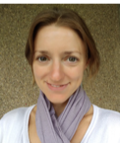
Welcome, apologies and introductions
Helen Granger
Curriculum area leader for the Maths PGCE
Notes:
Mentors all introduced themselves

Slide 3
Staffing Changes
Jill Barnard
One of the many joys of this job is visiting schools; meeting fellow maths teachers and finding out what is going on in the many wonderful maths departments into which we send our trainees.
We work with some terrific mentors at the University – and none more splendid than the maths lot!
Hard working, supportive, kind, thoughtful, generous with their time: maths teachers, so of course, plain speaking and no fuss.
Thank you for all of you for your kindness, support and tolerance over the past four years.
Thank you especially to Paula for letting us bring mathematical mayhem to Fulford, I’ve enjoyed working with you.
As my retirement beckons, I am sad to say farewell to you all.
You have been a pleasure and a joy to work with
Notes:
Jill Barnard retired this summer, here are the words she wished to share with you.

Slide 4
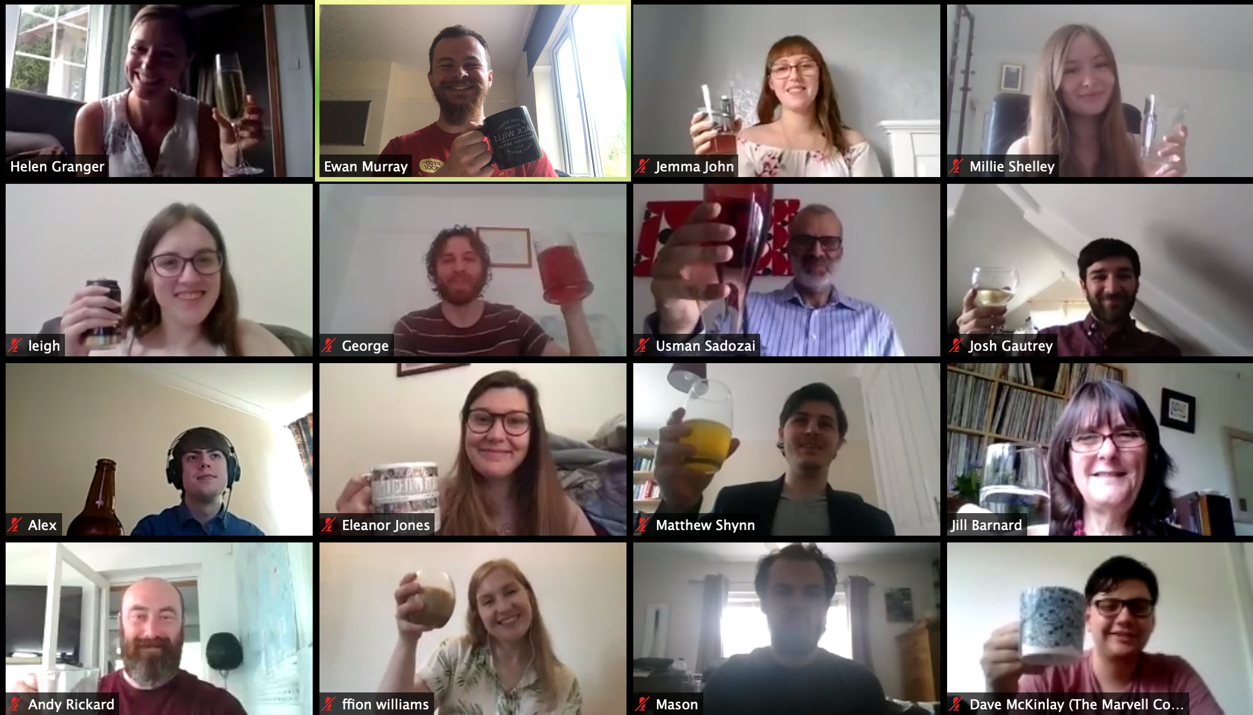
2. Cohort review
Notes:
After placements were suspended, we embarked on a fully online programme, taught sessions, peer teaching and tasks in order to successfully launch the cohort into their careers

Slide 5
 | 2018/19 | 2019/20
Trainees (including returners) | 22 | 17
Withdrawals | 3 (14%) | 1 (6%)
LOA | 3 | 2
Failed | 0 | 0
Recommended for QTS | 16 | 12 (2 undertaking additional placements)
Secured first post | 16 (100%) | 10 ( out of those who completed 83%)
Graded as at least ‘Good’ | 12 (100%) | 10 (83%)
Target - less than 15% withdrawal, 85% of those who gain QTS to secure a post, 80% to complete the course graded at least ‘Good’
Notes:
Lower starting number, withdrawal less, LOA comparable.
Pleased with anticipated completion rate when the additional placements are passed.
Pleased with number graded as Good – this grading was given 2 months earlier than normal

Slide 6
3. Cohort Overview
 | 2019/20 | 2020/21
Target | 24 | 24
Accepts on Core | 8 | 9
Accepts on Pathfinder | 5 | 4
Accepts on YTSA | 1 | 1
Accepts on DOMTSA | 0 | 0
Accepts on Teach North | - | 1
Notes:
Here are our figures for this year. We have new pathway with Outwood, Teach North. (Last year we recruited 14 then had 3 LOA returners - 17 in total).
We have recruited 15. Recruit next year maybe challenging with no SKE funding confirmed yet

Slide 7
15 new trainees
2 trainees on additional placements
2 trainees returning from leave of absence in February
Notes:
3 mature trainees, usual mix of SKE and maths degrees

Slide 8
4. Programme Overview
Induction week Subject Specialist Reflective Practitioner | Welcome and COVID safe working | Introductions Reflective Practitioners | Curriculum and Subject Knowledge | How to Make the Most of your PGCE
Understanding Learning | Theories of Learning Introduction to Teaching for Mastery | Assignment 1 | Mathematical Thinking | Introduction to lesson planning
Sequencing Learning | Resourcing a Learning Sequence | Mathematical Coherence - Geometry and Measure. | Planning a Learning Sequence. | Task: Prepare SEND presentation
Planning for Learning | Mathematical Variation - Ratio and proportion | Assessment for Learning in the Mathematics Classroom - Statistics | SEN in the Mathematics Classroom. Presentations | Task: Write assignment section
Enabling Learning | Mathematical Representations and Structures | Effective Differentiation in a Mathematical Classroom Mathematical - Algebra | Establishing Behaviour for Learning in a Mathematical Classroom | Task: Plan microteach Assignment tutorials
Embedding Learning | Mathematical Fluency | Task: Assignment 1 | Microteach Presentations | Assignment 1 support - drop in zoom session
Notes:
Blue is face to face
Moved to mastery units - https://www.ncetm.org.uk/classroom-resources/secondary-ite-professional-development-materials/
Opportunity to discuss how mentors can use this

Slide 9
5. Updates - Grading
Using the QTS assessment booklet and in discussion with the trainee, please record in the table below the trainee’s progress towards meeting Part One of the Teachers’ Standards where:
WT = Working Towards Meeting that Standard
BS = Below Standard
Please note that at this stage of their training it is anticipated:
the majority of trainees will be working towards (WT) all eight Standards;
a small number of trainees will have one or more Standards judged to be Below Standard (BS).
Standards: | WT/BS
TS1: Set high expectations which inspire, motivate and challenge pupils.
TS2: Promote good progress and outcomes by pupils.
TS3: Demonstrate good subject and curriculum knowledge.
TS4: Plan and teach well-structured lessons.
TS5: Adapt teaching to respond to the strengths and needs of all pupils.
TS6: Make accurate and productive use of assessment
TS7: Manage behaviour effectively to ensure a good and safe learning environment.
TS8: Fulfil wider professional duties.
Notes:
No grading
1st Review, just working towards or below standard.
In future reviews, each standard will be assessed as either a particular strength of the trainees, that the trainee is meeting the standard, positively working towards the standard or below standard.
For the final review, this 4 strands will be there however, each standard must be MET for the trainee to pass. ‘Working towards’, at the final review, denotes ‘failed’.

Slide 10
5. Updates - Target Setting
In discussion with your trainee please list 3 development targets (linked to the Teachers’ Standards) and suggest concrete actions the trainee can take to help them achieve these targets. Please note: Set one target that builds on an emerging strength/aspect of teaching the trainee enjoys.
Target area: | Actions to achieve targets:
Subject Specific:
General Teaching and Learning:
General Teaching and Learning:
Notes:
One target should build on something that they are good at or enjoy.

Slide 11
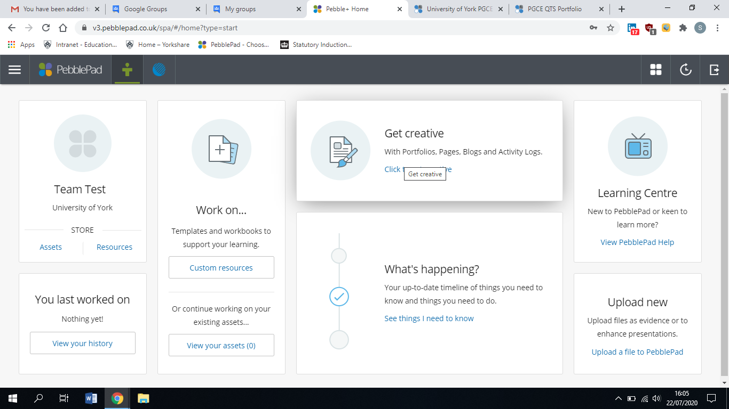
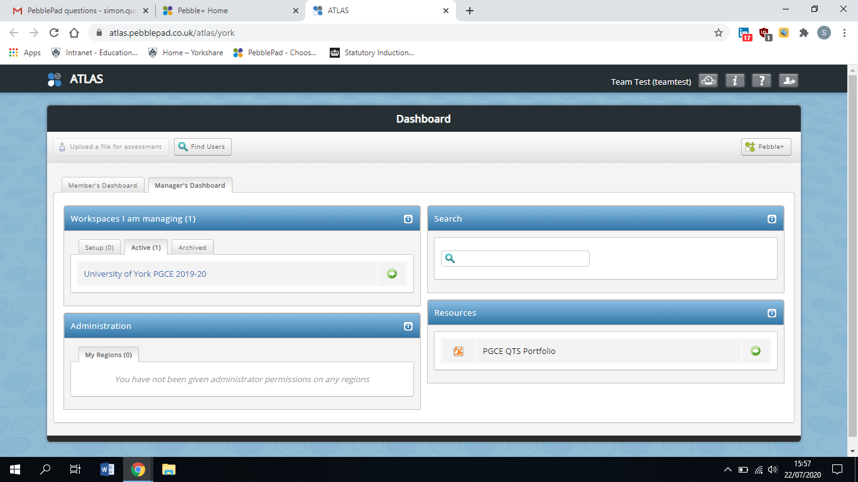
5. Updates - PebblePad
Notes:
https://www.york.ac.uk/education/pgce/mentors/documentation/
Reviews, mentor meetings, attendance logs and trainee evidence are now all to be captured on pebblepad.
Trainees are to upload one lesson plan/resource/evaluation a week.
You will need to be able to access this.

Slide 12
5. Updates - Action Plan
85% Completion
85% First posts
Subject and curriculum knowledge
Teaching for Mastery
Manage workload
Notes:
The first 2 are our standard metric.
Additionally we are looking at ways to support subject and curriculum knowledge - currently through peer teaching, more work over the summer, stronger auditing and reference to auditing.
We are sharing teaching for mastery material
Continuing to support trainees in managing their workload - they are already aware of this in their peer teaching

Slide 13
6. Questions

Slide 14
7. AOB
Notes:
Here we discussed the many things trainees need to be aware of when beginning their placements.

